Slide 1
WSSA Mini Leaders 20th January 2015 Speed Stacking Challenge !!

Slide 2
Aim
For you to work with other mini leaders from Worthing schools to;
Improve sporting opportunities
Raise Participation in schools
Be part of the WSSA Legacy Team
l

Slide 3
Meet the Legacy Team
Mini Leaders
Year 6/7 Leadership Academy
Sixth Form College Students
Apprentices
Staff

Slide 4
Objectives
To practice your leadership skills
To play different playground games
To set up and participate in playground challenges
To give you the confidence to set up playground challenges in your own school

Slide 5
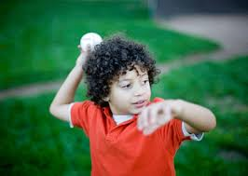
Playground Games
Rock, paper, scissors
Circle Tag
Passing the hoop around the circle
French skipping
Beat the ball
Under and Over

Slide 6
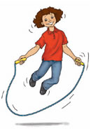
Playground Challenges
Skipping
Dribbling
Target Throwing
Running

Slide 7
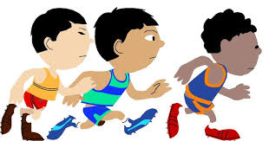
What next ?
Organise and run some playground challenges in your school.
Take some photographs of you organising and children participating in these challenges. Bring them along to our next meeting on 16th April 2015

