Slide 1
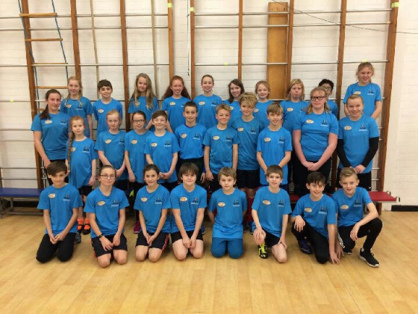
WSSA Legacy Leaders 2016/17 14th September 2017 4pm -5.30pm Chesswood Junior School

Slide 2
Why are you here ?
To improve your Leadership skills so you have the confidence and knowledge to lead competitions and festivals in your own school.
To share ideas to help encourage those who are less active to participate in PE and sport

Slide 3
Activities you can help with
Mo Farah Fun Run
Year 1/2 Indoor athletics

Slide 4
And some more …
KS 2 Boccia competition
New Age Kurling

Slide 5
Year 2 Legacy Games
Inter House Cross Country

Slide 6
Overall Plan
You will be invited to attend 4 sessions during the year on
14th September - Competition organisation
9th November - Disability events
18th January - Indoor athletics officiating
26th April - Legacy Games Preparation

Slide 7
Today
Work with other young leaders from Worthing schools and be part of the Legacy team
To learn about different ways of organising a tournament and run a mini tournament
Gain enough knowledge and confidence to run a competition in your own school.

Slide 8
Ladder
Compete in a ladder tournament
Rules
You may challenge anyone up to 3 places above you. If you win you take their place
You may not refuse a challenge
You have 10 min to complete the tournament. The winner will be the person at the top of the ladder when time is called.

Slide 9
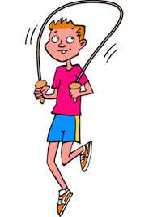
Knockout Tournament ( 10 sec skipping )
A ---------
B----------
C----------
D----------
-

Slide 10
Round Robin Can you work out all the possible games for a round robin competition with 4 teams on 2 courts ?

Slide 11
Hoop Ball
In your group read carefully the ‘3 Hoop Ball’ card
Once you are happy with the game, set your game up and start to play . Choose a team captain.
What official roles will you need if you were to play this game in a competition ?

Slide 12
Task- (to be completed by 9th November )
Organise a tournament for students in your school. This may be ladder, knockout or round robin based and run at a time to suit the school and yourself.
Please take photos of your event and be prepared to feedback to everyone at the next session.
Enjoy being a Legacy Leader!!

